Slide 1

A project to explore the major regions, localities (neighbourhood) & cities within the state of New South Wales Australia
Gbenga Afuape

Slide 2
Introduction
A migration agent targeting African Clients called Aus-Migration Pty has required my services in providing major regional distribution of people within the state of New South Wales in Australia. The client would be interested in knowing:
What the sizes of those regions are (km2),
In seeing the distribution of population for the years 2018 and 2019 respectively and the population density for the year 2019 specifically.
Component reasons for the distribution for the year 2019.
Visualize and high some of the regions impacted by the 2019/2020 bush fires
Segment the neighbourhoods to assist the broad potential clients(Students, professionals, entrepreneurs etc) on neighbourhoods that would be of interest.

Slide 3
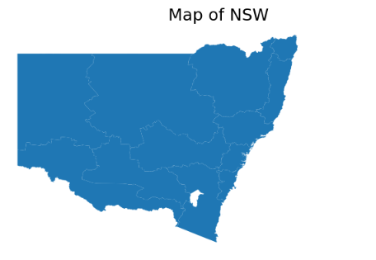
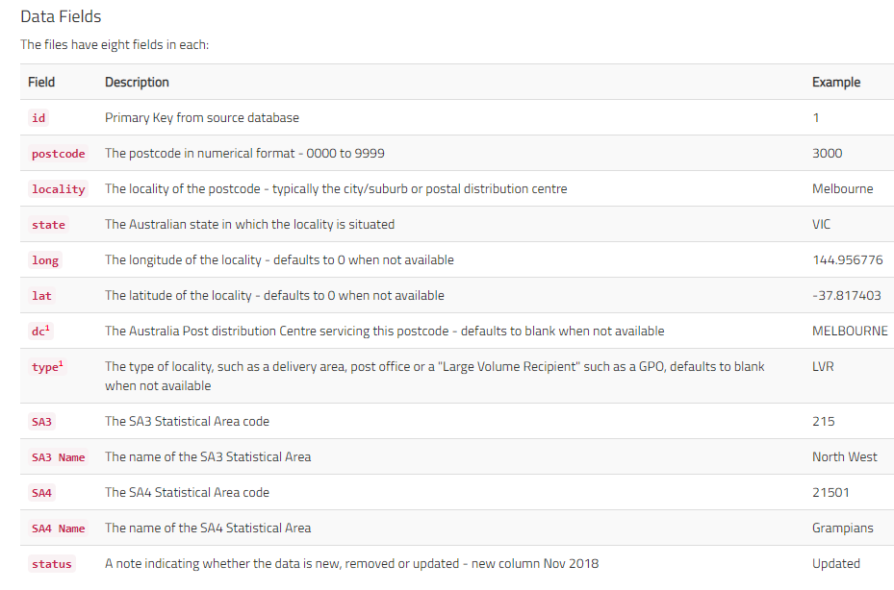
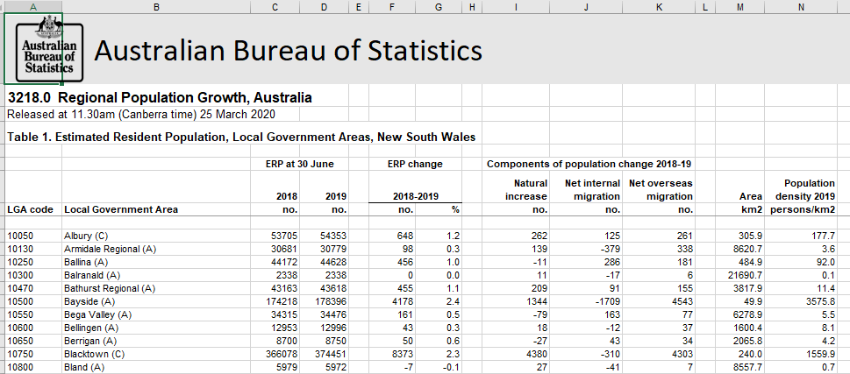
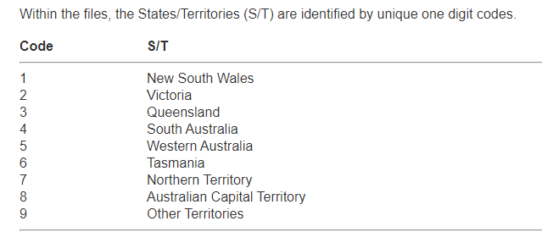
Data Acquisition and Wrangling
3 Main Data Sources
-Australia Post
-Australian Bureau of Statistics
FourSquare Location Database & API
Over 5000 post codes in NSW, 12 Major Statistical regions.or locality3 Main Data Sources

Slide 4
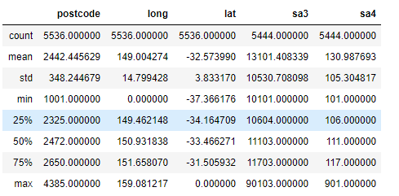
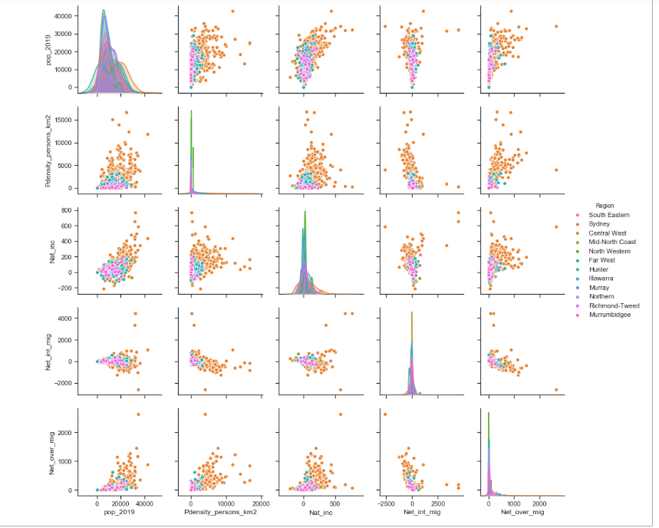
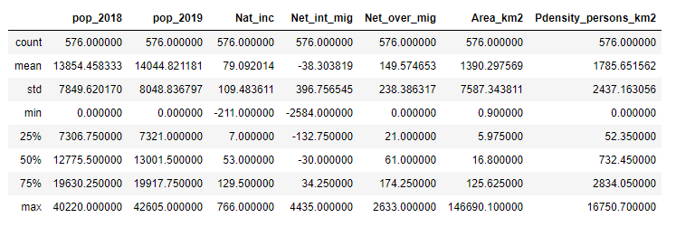
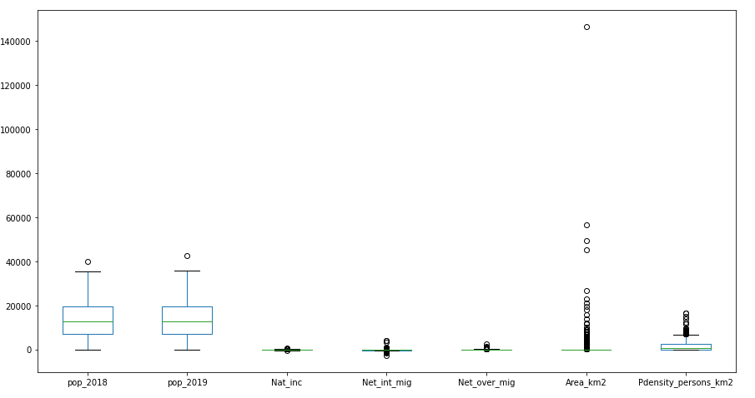
Exploratory Data Analysis & ML
Sydney continues to experience disproportionate increase in population and remains the most densely populated city in NSW(Australia)
In 2019 Net overseas migration was a contributing factor but not as much as the natural increase.
2019 did experience some out of city migration from Sydney to other cities(or state)
Unsupervised Clustering algorithm(K-means Clustering) was used to segment the neighborhoods (5 vs6; 5km vs 2km radius search for FourSquare)

Slide 5
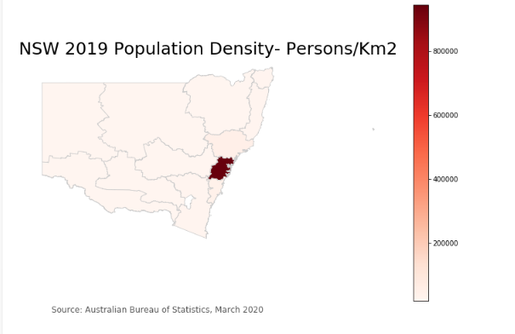
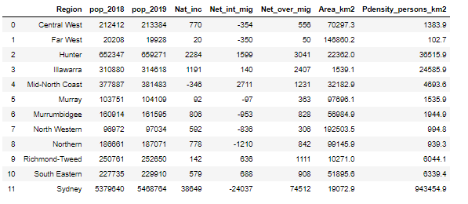
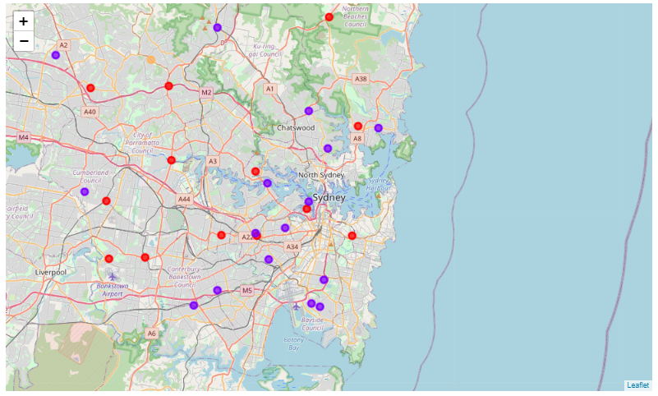
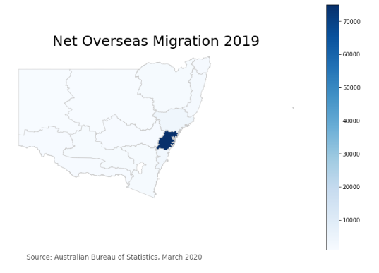
Results and Discussions
Sydney continues to be destination of choice for overseas migrants .
There are ample neighbourhoods other than Sydney that share similar characteristics at a smaller scale than Sydneyiving
Clusters 1 and 2 provide ample neighbourhoods to explore Café or catering business.
Student (ample opportunity to get part-time work to supplement their finances) should explore the neighbourhoods in Cluster 2 where the 2 prestigious universities(UNSW and Univ Sydney) are located.
Cluster 4 and 5 (mainly Sydney outer west) would support outdoor related businesses and farming and specialist doctors needing to be in regional areas.

Slide 6
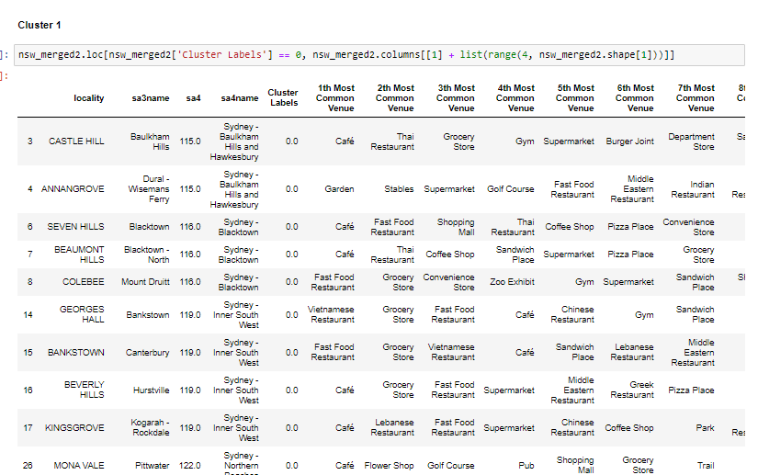
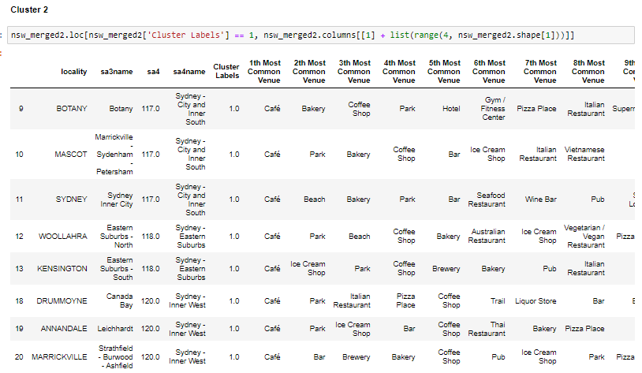
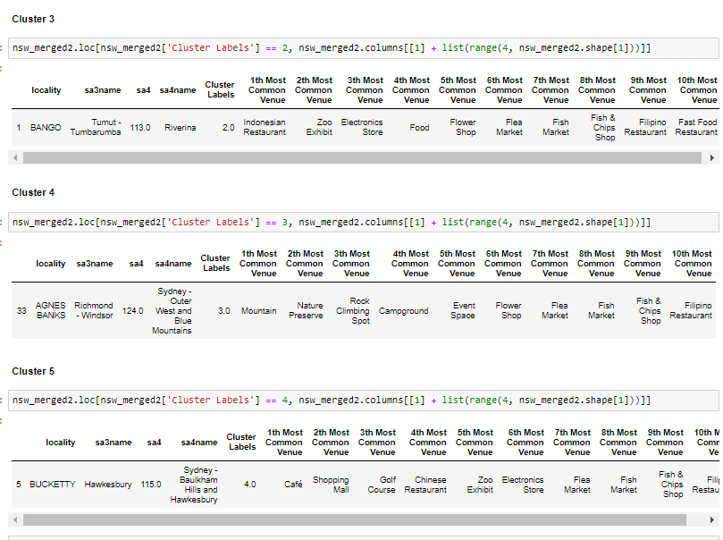
Results and Discussions

Slide 7
Conclusion
The New South Wales population data for 12 major regions have been put through an unsupervised clustering. We have been able to successfully segment the NSW into 5 clusters.
Clusters 1 has about 20 localities (neighbourhoods) which are mainly in the Sydney City, inner west, inner south and the northern beaches.
Cluster 2 bounds another 21 localities (or neighbourhoods) and interestingly some of these are in the inner west of Sydney, north Sydney and South west.
Clusters 3,4 and 5 have 1 neighbourhood each.
The unsupervised Clustering algorithm (k-means) for this work was not sensitive to the radius (5km vs 2km) used in making calls to the Four Square Database nor increasing the clusters to 6.
We have successfully made use of the population data from the Australian Bureau of Statistics and the Four Square API to determine the 5 clusters of neighbourhoods in New South Wales or within the 12 major statistical divisions.

